Slide 1
V3.1.0
New Features and Process

Slide 2
Enhancements
Sales Functionality
Invoice
Hold & Layaway
Cashout Process
Cashout Report
Inventory Home Page

Slide 3
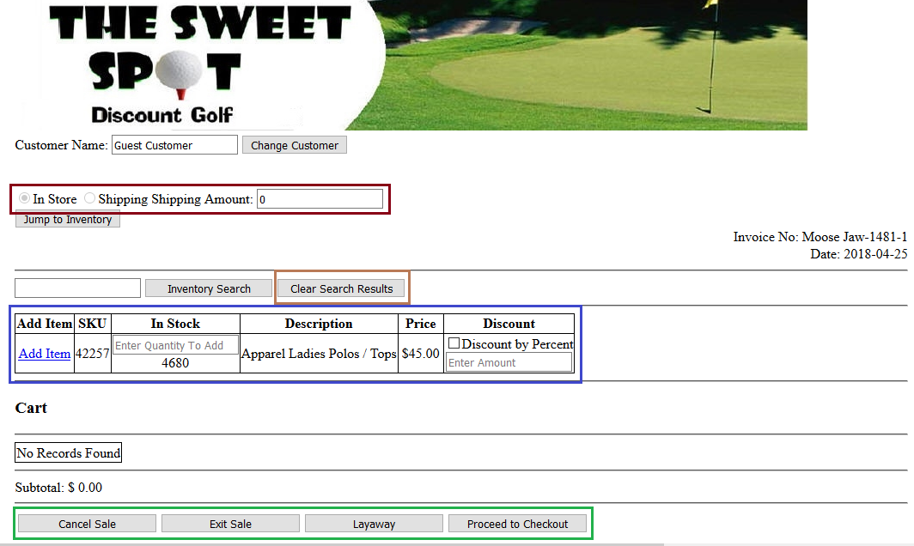
Sales Functionality
When in a Sale there is some new functionality that you will notice. The first to make note of is the is that the In Store and Shipping radial buttons are no longer functional. To charge shipping change the amount in the shipping box to anything other than $0.00. This will automatically switch the radial button from In Store to Shipping. Changing the amount back to $0.00 will reverse the radial button change. (Dark Brown)
Next will be the Clear Search Results button, this will essentially just as the name suggests clear the grid of previously searched items showing no results. (Light Brown)

Slide 4
Sales – On Hold & Layaway
During a sale, you can now put it on hold by clicking the Exit Sale button. This will allow you to come back to the sale at a later point
If the sale is a layaway, you are able to mark it as such by clicking the Layaway button located on the cart, and checkout page

Slide 5
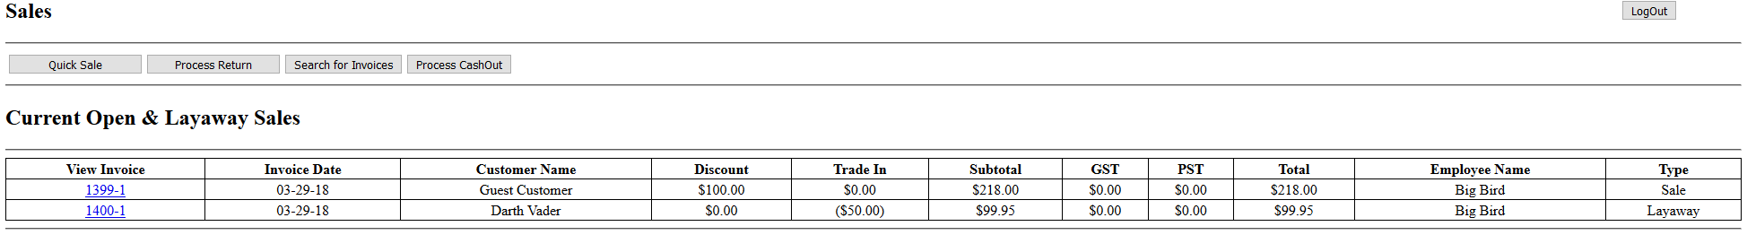
Sales – On Hold & Layaway Cont.
Sales that are on hold or are a layaway are shown on the sales homepage
Resuming one of these sales can be done by clicking on the invoice number

Slide 6

Sales – Shipping Amount
You no longer need to select Shipping to add a shipping amount to the sale. Now you just need to enter in an amount greater than zero into the Shipping Amount textbox and it will be added to the sale

Slide 7
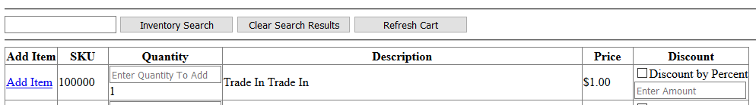
Sales – Refresh Cart
A button was added that will allow you to refresh the cart. The reason for this is because a trade-in item will not show unless the cart is refreshed
This button will only appear when a trade-in is added to the cart and will disappear once it is clicked

Slide 8
Invoices – Printing
The invoices have had a couple minor changes to them
The changes involve text size, spacing and positioning
This will reduce the amount of paper needed to print an invoice

Slide 9
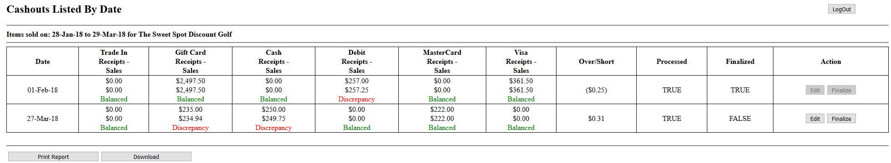
Reports – Cashouts
There is a new cashout report that can be found in the Reports tab
Here, you can view, edit and finalize previous cashouts
The process of doing a cashout has not changed. The one thing to pay attention to is that the button to start the cashout has been moved to the Sales page

Slide 12
Bug Fixes
The trade-in amount is now being properly applied to the Extensive Invoice report

